Slide 1
Using Advanced Vector Extensions AVX-512 for MPI Reductions
Dong Zhong, Qinglei Cao, George Bosilca, and Jack Dongarra
EuroMPI 2020

Slide 2
Outline
Motivation
Evaluation
Conclusion and Future work
Background
Design and implementation

Slide 3
Motivation & Background

Slide 4
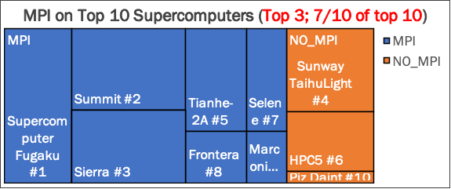




Why MPI: Supercomputer, Cloud computing, Distributed ML
Goal: To deliver the best performance on all systems (performance portability), which means being able to take advantage of the all hardware capabilities.

Slide 5
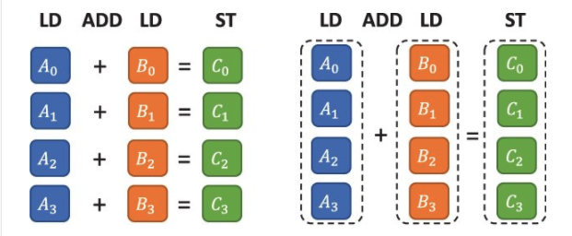
Reduction: Scalar & Vector operation

Slide 6
Reduction: Scalar & Vector operation

Slide 7
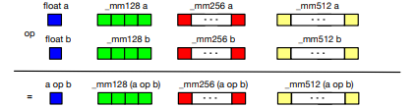
Reduction: Scalar & Vector operation
AVXs with long vector load, store, and operations
AVX2: 8 integers or floating- point AVX512: 16 integers or floating-point

Slide 8
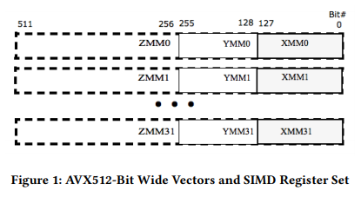
Intel Advanced Vector Extension (AVXs)
SSE4
AVX
Sandy Bridge
AVX2
Haswell
AVX512
Xeon
The lower 256-bits of the ZMM registers are aliased to the respective 256-bit YMM registers and the lower 128-bit are aliased to the respective 128-bit XMM registers.
XMM
128-bit
SIMD
Y | XMM
Operate on
256-bit
registers
Z | Y | XMM
Operate on
512-bit
registers

Slide 9
Motivation: MPI reduction operation
Traditional HPC application
Computation-oriented collective operations such as MPI_Allreduce and MPI_Reduce perform reductions on data along with the communications performed by collectives.
Optimizations in each reduction operation drives up the collective performance, which benefits the overall application performance.
Machine learning and distribute training
Reduction of the gradients
Number of reduction operations is significant during single run.
The data size used by each reduction operation is extremely large (with an extensive training model, the data could be in the hundreds of megabytes).

Slide 10
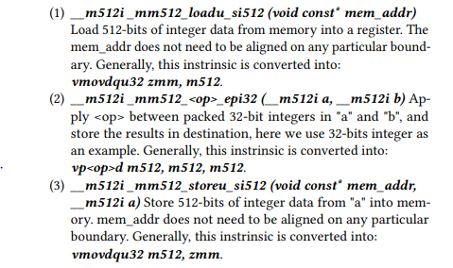
AVXs intrinsic
Built-in functions that provide access to the ISA functionality using C/C++ style coding instead of assembly language.
Cost of writing and maintaining programs with intrinsic is considerably less than writing assembly code.
Intrinsic allows developers to obtain performance close to the levels achievable and feasible with assembly.

Slide 11
Design & Implementation

Slide 12
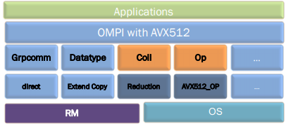
Design and implementation in Open MPI
Figure 4: Open MPI architecture. Orange boxes represent components with added AVX-512 reduction features. Dark blue colored boxes are new modules
We add our AVX-512 optimization in a specialized component that implements all predefined MPI reduction operations with vector reduction instructions

Slide 13
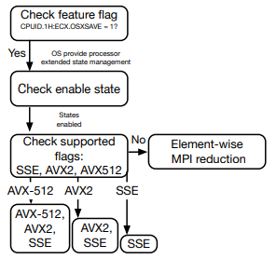
Design and implementation in Open MPI
Figure 4: Open MPI architecture. Orange boxes represent components with added AVX-512 reduction features. Dark blue colored boxes are new modules
Figure 5: Integrate and automatically activate the AVX component into the Open MPI build system
From a practical standpoint, our module extracts and checks the processor feature flag, selecting at runtime the set of ISA (AVX-512, AVX2 or AVX/SSE), or fallback to the default basic module.
Detecting compiler flags and specializing different versions of MPI_OP for different instruction sets is complex.
We add our AVX-512 optimization in a specialized component that implements all predefined MPI reduction operations with vector reduction instructions
From a practical standpoint, our module extracts and checks the processor feature flag, selecting at runtime the set of functions supporting the most advanced ISA (AVX-512, AVX2 or AVX/SSE), or fallback to the default basic module.

Slide 14
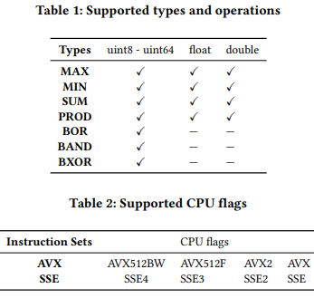
Design and implementation in Open MPI
Figure 4: Open MPI architecture. Orange boxes represent components with added AVX-512 reduction features. Dark blue colored boxes are new modules
Figure 5: Integrate and automatically activate the AVX component into the Open MPI build system
We add our AVX-512 optimization in a specialized component that implements all predefined MPI reduction operations with vector reduction instructions
From a practical standpoint, our module extracts and checks the processor feature flag, selecting at runtime the set of ISA (AVX-512, AVX2 or AVX/SSE), or fallback to the default basic module.
Detecting compiler flags and specializing different versions of MPI_OP for different instruction sets is complex.
Table 1 shows various MPI_Types and MPI_Ops are supported, which lists all combination of types and operations defined by the MPI standard.
Table2 lists supported instruction sets and related CPU flags from legacy SSE to the latest AVX-512 instruction sets.
Notes:
logic to handle different architectural capabilities Detect the compiler flags necessary to build specialized versions of the MPI_OP. Once the different flavors (AVX512, AVX2, AVX) are built, detect at runtime which is the best match with the current processor capabilities.

Slide 15
Fully optimization (avx512 -> avx2 -> avx -> Duff device)
(1) AVX512
(2) AVX2
for( ; left_over >= types_per_step; left_over -= types_per_step ) {
__m512i vecA = _mm512_loadu_si512((__m512*)in);
in += types_per_step;
__m512i vecB = _mm512_loadu_si512((__m512*)out);
__m512i res = _mm512_and_si512(vecA, vecB);
_mm512_storeu_si512((__m512*)out, res);
out += types_per_step;}
for( ; left_over >= types_per_step; left_over -= types_per_step ) {
__m256i vecA = _mm256_loadu_si256((__m256i*)in);
in += types_per_step;
__m256i vecB = _mm256_loadu_si256((__m256i*)out);
__m256i res = _mm256_and_si256(vecA, vecB);
_mm256_storeu_si256((__m256i*)out, res);
out += types_per_step; }
#define current_func(a, b) ((a) & (b))
while( left_over > 0 ) {
int how_much = (left_over > 8) ? 8 : left_over;
switch(how_much) {
case 8: out[7] = current_func(out[7], in[7]);
…
case 1: out[0] = current_func(out[0], in[0]); }
for( ; left_over >= types_per_step; left_over -= types_per_step ) {
__m128i vecA = _mm_lddqu_si128((__m128i*)in);
In += types_per_step;
__m128i vecB = _mm_lddqu_si128((__m128i*)out);
__m128i res = _mm_and_si128(vecA, vecB);
_mm_storeu_si128((__m128i*)out, res);
out += types_per_step; }
(4) Duff
(3) AVX

Slide 16
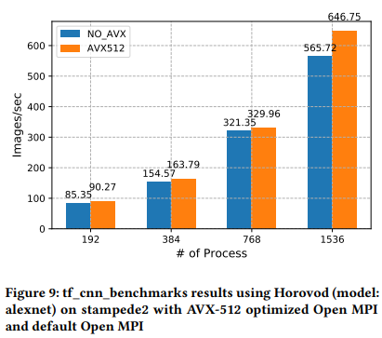
Deep Learning Application Evaluation
Comparing to element-wise reduction, with the increasing number of processes, our design shows increasing improvements, which start at 5.45% and eventually rise to 12.38% faster than default Open MPI on 192 processes and 1536 processes, respectively.
We notice that the performance benefit increases with more processes. It is because with more MPI processes participated in reduction operation: (1) the fact that each one of them is simultaneously using our AVX optimized Open MPI operations drives up the overall application performance; (2) the total size of weights for reduction increases significantly, which means reduction dominates the overall runtime. The more we speedup reduction latency the more we can contribute to the overall application performance.

Slide 17
Performance tool evaluation (PAPI)
Overview: Number of total instructions, memory access instructions (load and store), and branch instructions. Experiments are conducted on Xeon (AVX512f) based cluster.
Reduced the number of loads and stores instructions by a factor of 90X and 60X, respectively.
For branching instructions, decreased by 60X.
Notes:
PAPI_LST_INS. Total load/store instructions executed

Slide 18
Performance tool evaluation (PAPI)
Branching instructions: including branch instructions taken and not-taken; Instructions mis-predicted and instructions correctly predicted, which have significant impact on performance.
Using long vectors largely decreased (512 bits / 8 bits) the “for loop” in reduction operation, which reduced control and branching instructions.
Notes:
PAPI_BR_UCN Unconditional branch instructions executed
PAPI_BR_CN Conditional branch instructions executed
PAPI_BR_NTK Conditional branch instructions not taken
PAPI_BR_MSP Conditional branch instructions mispredicted
PAPI_BR_PRC Conditional branch instructions correctly predicted

Slide 19
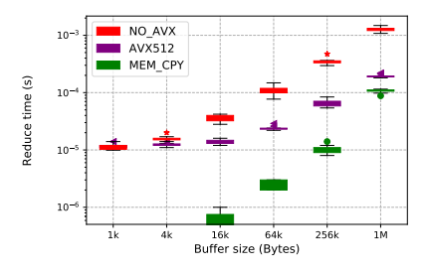
Experimental evaluation
Div 0
Comparison of MPI_BAND with AVX-512 reduction enable and disable for MPI_UINT8_T together with memcpy
We conduct experiments on a local cluster which is an Intel(R) Xeon(R) Gold 6254 (AVX512F) based server. Our work is based upon Open MPI master branch, revision #75a539. Each experiment is repeated 30 times.
Figures show the results of MPI_BAND. It should be noted for default OMPI, despite the provided optimization compiling flags, it did not generate auto-vectorized code. Our optimization is using intrinsic which gives us complete control of the low-level details at the expense of productivity and portability.
Reduction is memory bound operation; thus we aim to compare with the maximum archivable memory bandwidth (aka memcpy). We can see our optimized implementation performance increases with buffer size and catches up with memcpy even with computation included.

Slide 20
Conclusion & Future work
Conclusion
Introduce new reduction operation module in OMPI using AVXs’ intrinsic supporting different kinds of MPI reduce operations for multiple MPI types.
Experiments with PAPI and MPI_Reduce, which shows our implementation largely decreased instruction counts and achieve 10X speedup for large buffer size (1MB).
Experiments with Horovod for image processing application, our new reduction strategy achieves a significant speedup across all ranges of processes, reaches a 12.38% improvement with 1536 processes.
Future work
We can apply the same principles to datatype engine (AVX gather and scatter);
Extend this work to other instruction set architectures (ISA). (eg : Armv8 with SVE).

Slide 21
Question?

