Slide 1

Evaluating MPI Message Size Summary Statistics
The 27th European MPI Users’ Group Meeting, Austin, TX, USA, September 21–24, 2020 (EuroMPI/USA ’20)
Kurt B. Ferreira & Scott Levy

Slide 2
Why we should stop using the mean when we discuss likely MPI message sizes.
The 27th European MPI Users’ Group Meeting, Austin, TX, USA, September 21–24, 2020 (EuroMPI/USA ’20)
Kurt B. Ferreira & Scott Levy

Slide 3


The Authors
Kurt B. Ferreira
Sandia National Laboratories
Scott Levy
Sandia National Laboratories

Slide 4
In this work, we show:
The average (mean), while easy and efficient to calculate, may not be a good representation of all subsets of application messages sizes, with median and mode of message sizes being a superior choice in most cases.
The problem with using the average relates to the multi-modal nature of the distribution of point-to-point message sizes.
That scaling a workload typically has little discernible impact on which metrics are best representatives of the underlying data.
Varying input descriptions can significantly impact which metric is most representative.

Slide 5
Why is this important?
Goal is to provide guidance for how we as community should discuss and analyze MPI message size data for scientific applications.

Slide 6
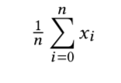
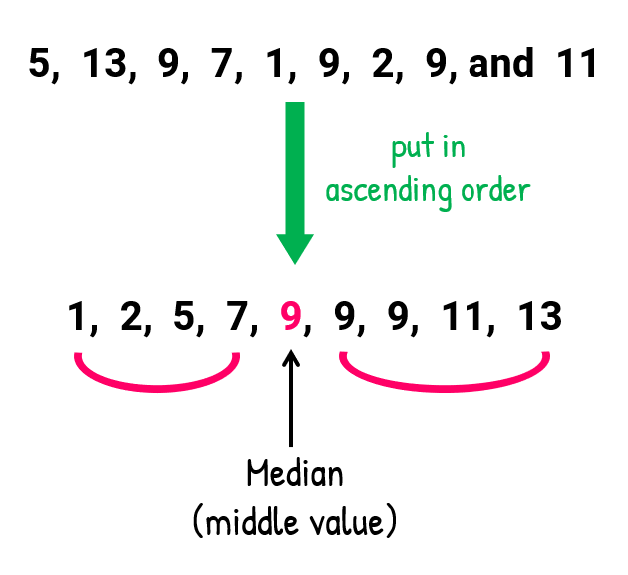
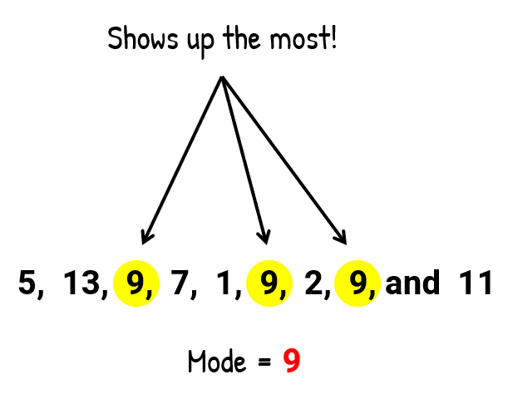
First, Some Terminology on Measures of Central Tendency
Arithmetic mean (average):
Median: the middle value in the sorted dataset
Mode: the most common value in the dataset

Slide 7




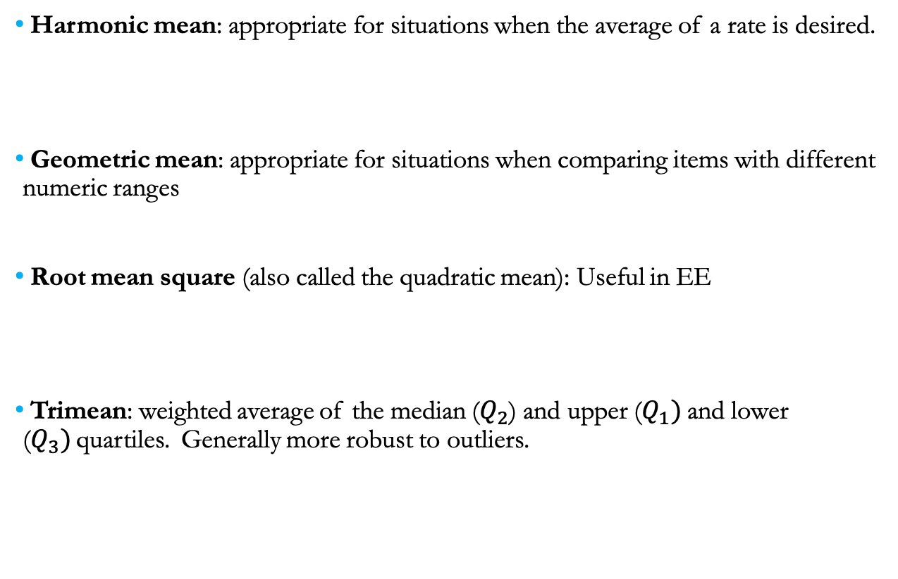
First, Some Terminology on Measures of Central Tendency
Harmonic mean: appropriate for situations when the average of a rate is desired.
Geometric mean: appropriate for situations when comparing items with different numeric ranges
Root mean square (also called the quadratic mean): Useful in EE
Trimean: weighted average of the median ($Q_{2}$) and upper ($Q_{1})$and lower ($Q_{3})$quartiles. Generally more robust to outliers.

Slide 8
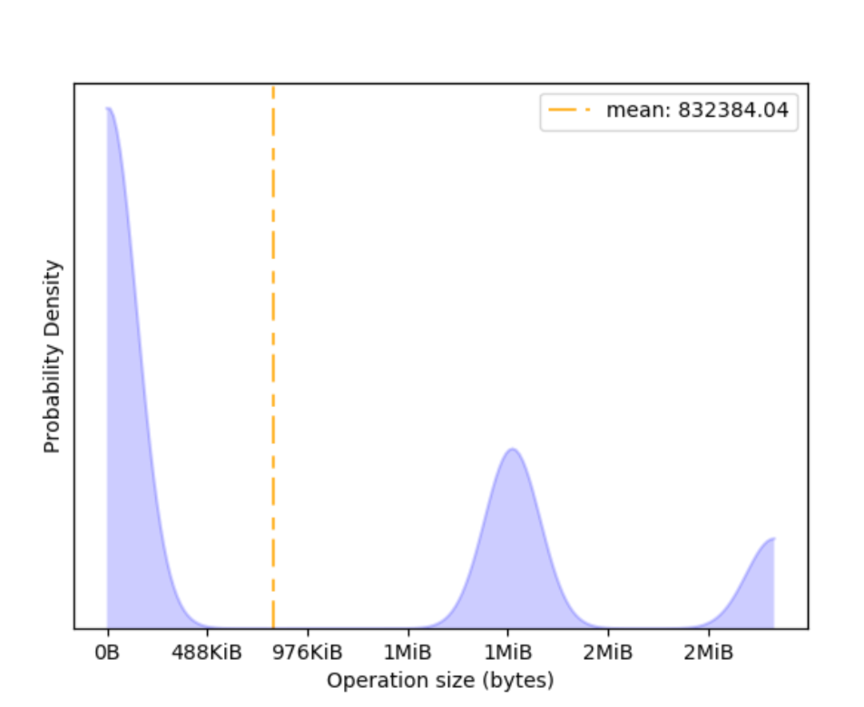
Problem: Mean as a Representative Metric for CTH
Higher == more messages of that size sent within app run
Question: How representative of underlying data is the mean?

Slide 9
Taking a Step Back: Trace Collection Framework
We use previously collected and validated MPI message size traces from a number of key scalable production workloads and proxy applications.
Traces collected using LogGOPSim framework from Hoefler et al @ ETH.
Analysis includes message sizes for all explicit MPI messaging functions.
Data is tagged such that we can perform analysis on subsets of the data (e.g. Point-to-points, collectives, etc.).

Slide 10

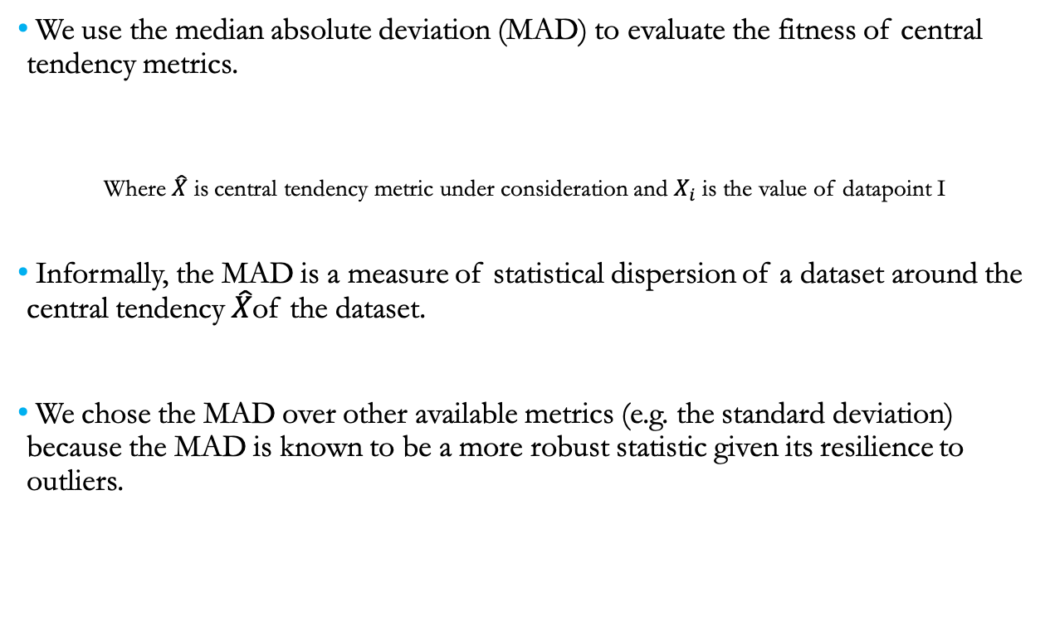
Taking a Step Back: Evaluating Central Tendency Metrics
We use the median absolute deviation (MAD) to evaluate the fitness of central tendency metrics.
Where $\hat{X}$ is central tendency metric under consideration and $X_{i}$ is the value of datapoint I
Informally, the MAD is a measure of statistical dispersion of a dataset around the central tendency $\hat{X}$of the dataset.
We chose the MAD over other available metrics (e.g. the standard deviation) because the MAD is known to be a more robust statistic given its resilience to outliers.

Slide 11
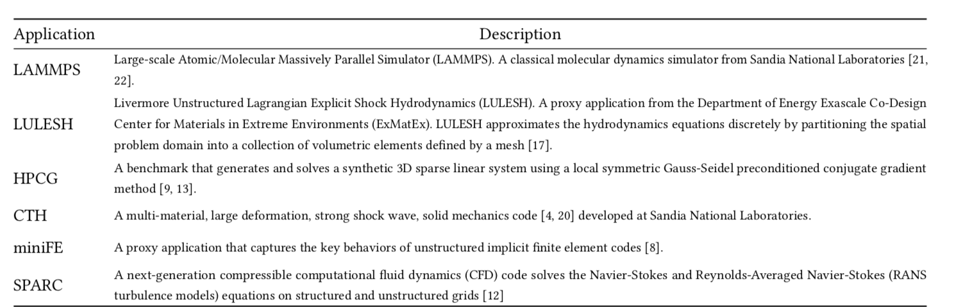
Taking a Step Back: Workloads Considered

Slide 12
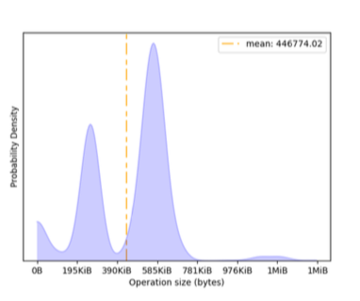
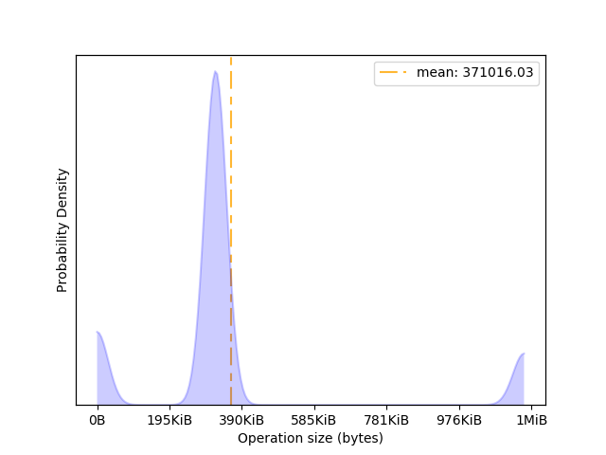
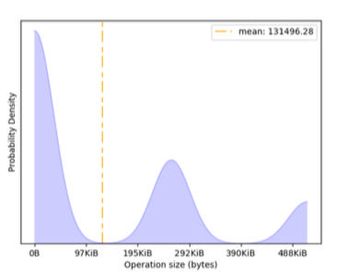
Mean a Poor Representative for Most Workloads
CTH
LAMMPS
SPARC
MiniFE

Slide 13
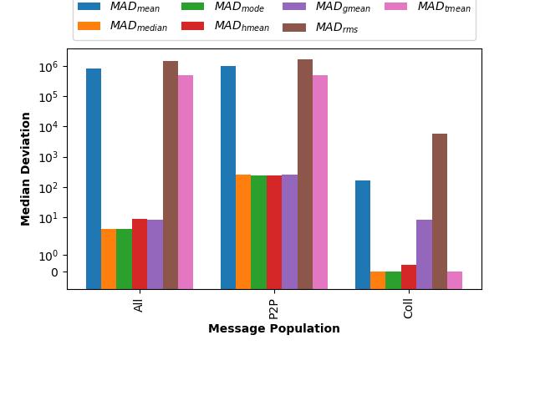
Median and Mode Better Represent CTH Data Than Mean
Lower is better fit
Median and Mode have lower MAD values for All messages

Slide 14
Results Similar for Point-to-point and Collective Operations
But, deviation for mean is much lower for collectives

Slide 15
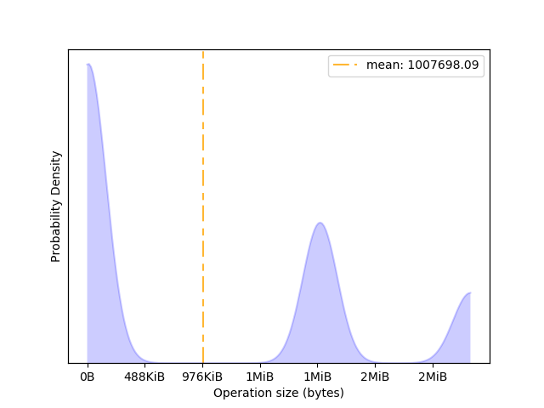
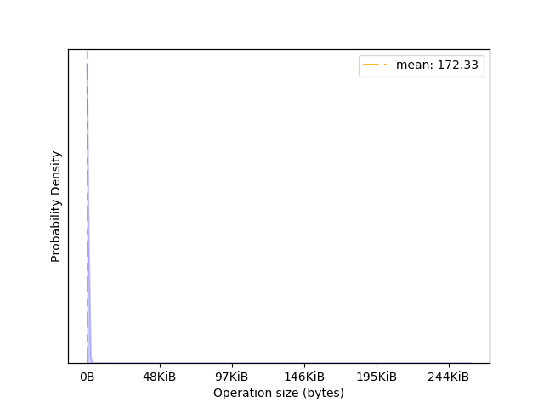
Mean May be OK for Collectives with CTH
P2P
Greater diversity of message sizes for
P2P vs COLL, therefore mean a better
representative for collectives
COLL

Slide 16
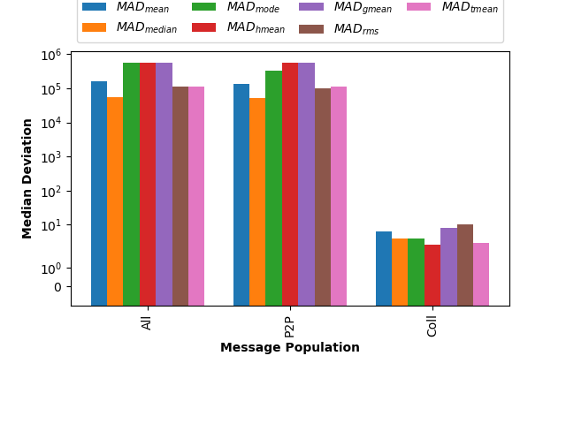
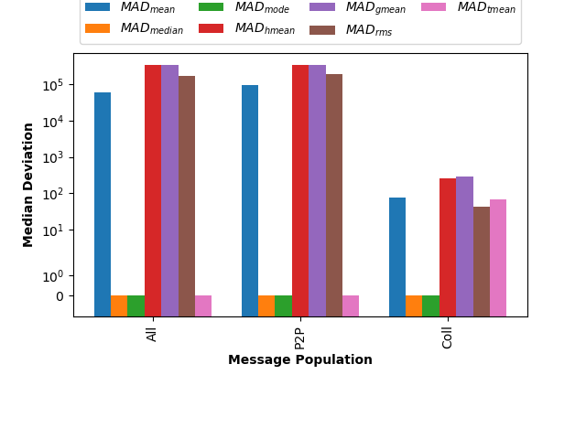
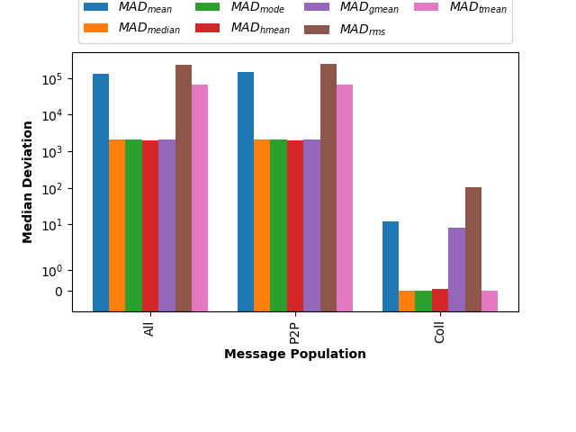
Results Similar for All Workloads Tested
CTH
LAMMPS
Mean tends to be poor representative
Median (mode) tend to be the better representative
SPARC
MiniFE

Slide 17
Results Similar for All Workloads Tested
CTH
LAMMPS
Mean may be reasonable metric for collectives
SPARC
MiniFE

Slide 18
Additional Questions
How does application scaling impact these measures of central tendency?
What is the impact of different application inputs?

Slide 19
Additional Questions
How does application scaling impact these measures of central tendency?
What is the impact of different application inputs?

Slide 20
Does Scaling Have an Impact?
Weak Scaling? The message data distribution is nearly exact, therefore no significant impact on dispersion.
Strong Scaling? The point-to-point distribution changes so …

Slide 21
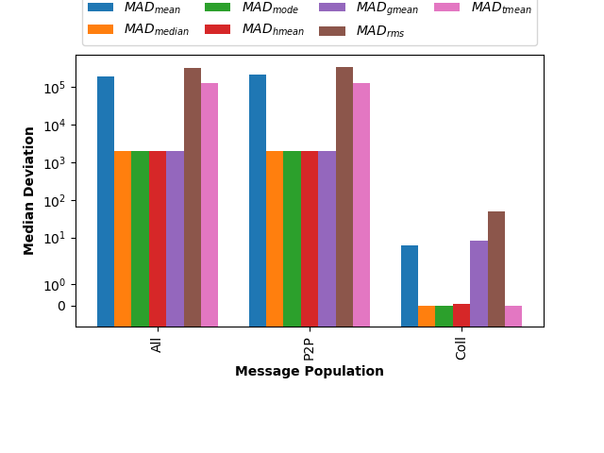
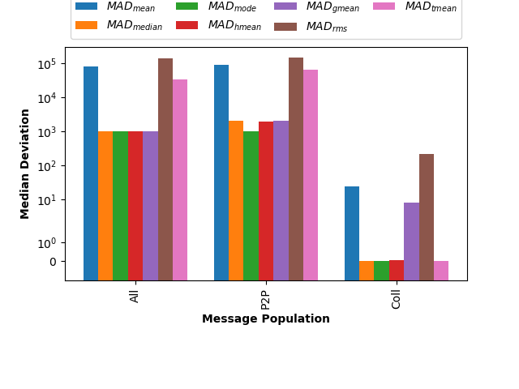
Strong Scaling for MiniFE
64
128
256
For each node count, the relative statistical dispersion remains stable
Therefore, scaling seems to have little impact
More details and apps in the paper

Slide 22
Additional Questions
How does application scaling impact these measures of central tendency?
What is the impact of different application inputs?

Slide 23
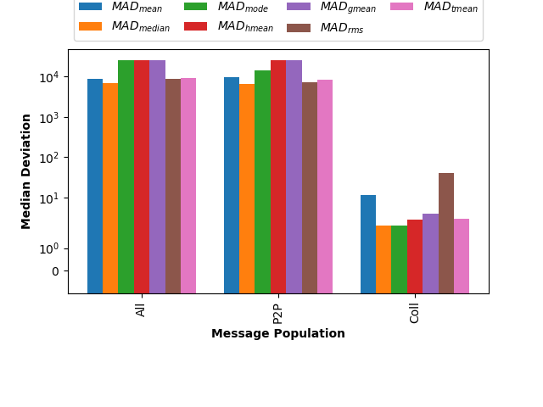
Central Tendency Metrics Sensitive to LAMMPS Input
LAMMPS-lj
LAMMPS-snap
While shape of deviations are similar, there is an order of
magnitude difference in magnitude between the two inputs.
Therefore, metrics seem sensitive to application inputs
More details and apps in the paper

Slide 24
Summary & Lessons Learned
Arithmetic mean not a good representative: While widely used, easily understood and efficient to compute, the arithmetic mean may not be a good representative of MPI message size data. The median and mode are typically better choices. The mean is generally more useful when discussing more specific MPI operations (for example MPI_Allreduce(), etc.).
Non-traditional means no better than standard mean: Variants on the arithmetic mean (e.g. trimean, quadratic, harmonic, geometric means) are little better than the mean itself. Though these more sophisticated calculations are meant to better represent complex data (by, for example, filtering outlier data), they also perform poorly with the discrete multi-modal nature found in workload message size data.
Scale does not typically impact metrics: Application scale seems to have little impact on fitness of a summary statistic. For weak-scaling, the message data distribution is nearly exact. For strong-scaling, while the message size data changes, the distribution shapes stay similarly. Therefore, a representative metric at one scale is likely a good representative at other scales.
Inputs influence metrics: Changing the input description for a particular workload has the potential to impact the degree to which a measure of central tendency is representative of a message size dataset. As a result, the determination of how to best represent the central tendency of a message size dataset necessarily needs to include consideration of the target input.

Slide 25
Questions?
Kurt B. Ferreira
kbferre@sandia.gov
Scott Levy
sllevy@sandia.gov
Sandia National Laboratories is a multi mission laboratory managed and operated by National Technology and Engineering Solutions of Sandia, LLC., a wholly owned subsidiary of Honeywell International, Inc., for the U.S. Department of Energy’s National Nuclear Security Administration under contract DE-NA0003525.

